Slide 1
Student Affairs Key Performance

Slide 2
Disruption
Division does not currently have well defined understanding of which of their key performance measures contribute to student success.

Slide 3
Key performance Measures
Sense of Belonging
Level of University Engagement
Thoughts of Leaving School
Resiliency
Satisfaction

Slide 4
Proposed Outcomes
Academic Success
Retention
Graduation

Slide 5
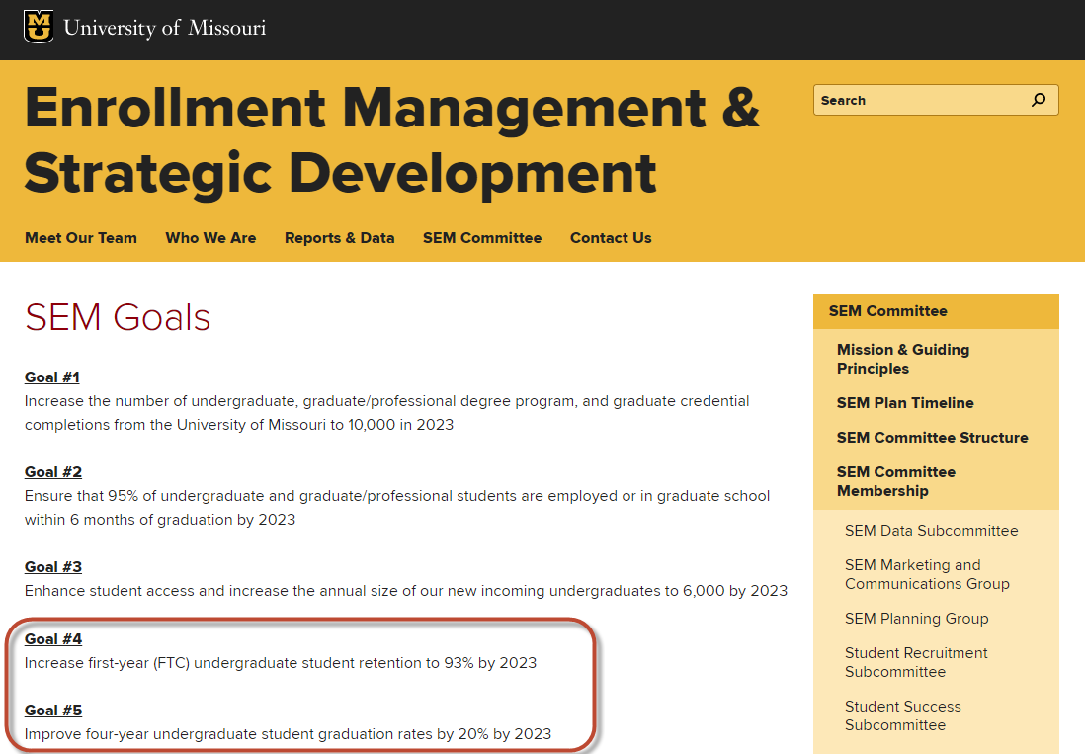

Slide 6
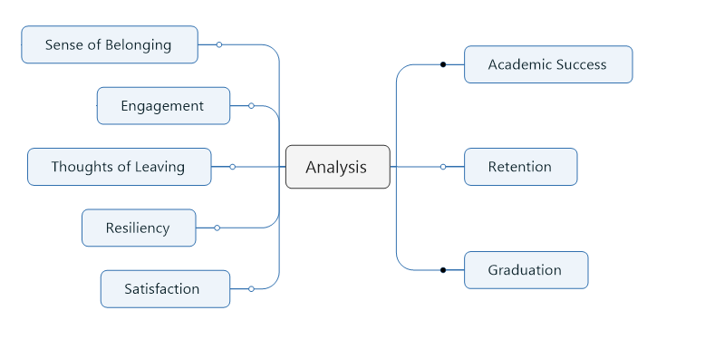

Slide 7
Data Sources
Student Experience Survey (CampusLabs – SPSS)
Student Information System (SQL & Tableau)
Retention Table
Census Data
OrgSync – Campus Involvement (API to Excel)
MU Connect – Predictive Analytic Module (API to CSV)

Slide 8
2017 Student Life Survey
Implemented Spring of 2017 – related to Outcomes measure in Spring 2018
1,247 Responses from 7,000 randomly sampled students
5,000 Undergraduates (N = 877)
2,000 Graduates (N = 370)
18% Overall Response Rate
17.5% Undergraduate
18.5% Graduate
Notes:
Note – confidential study

Slide 9
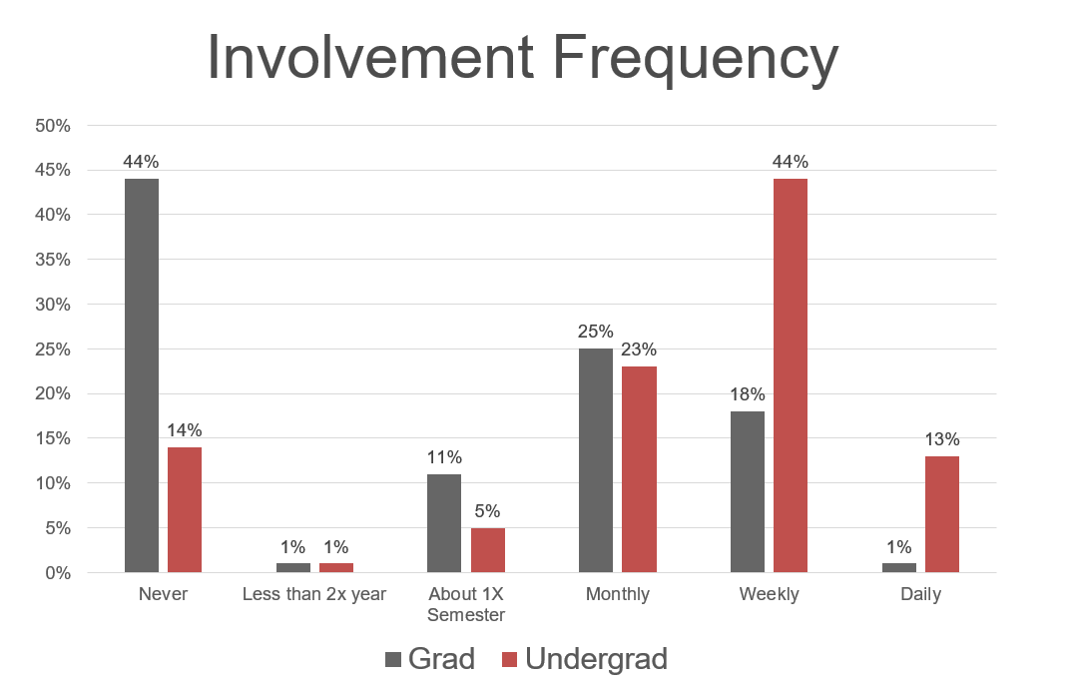
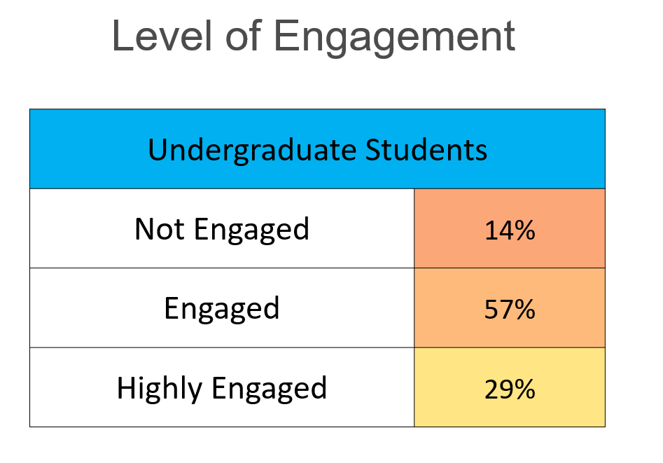
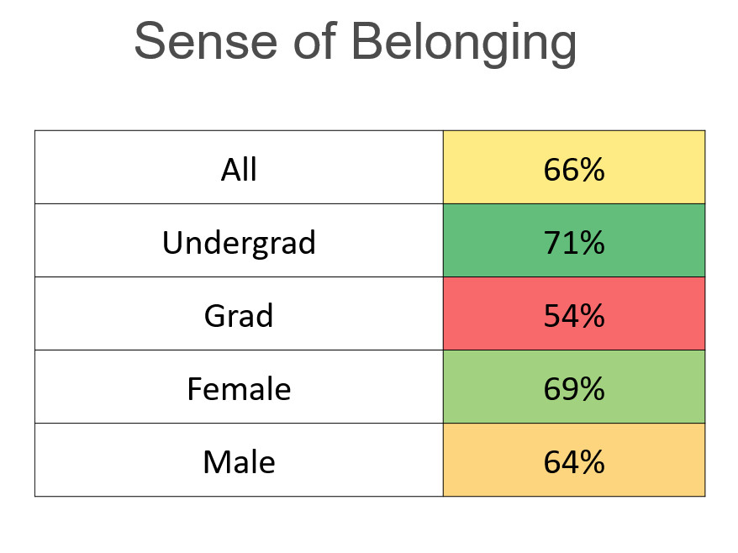
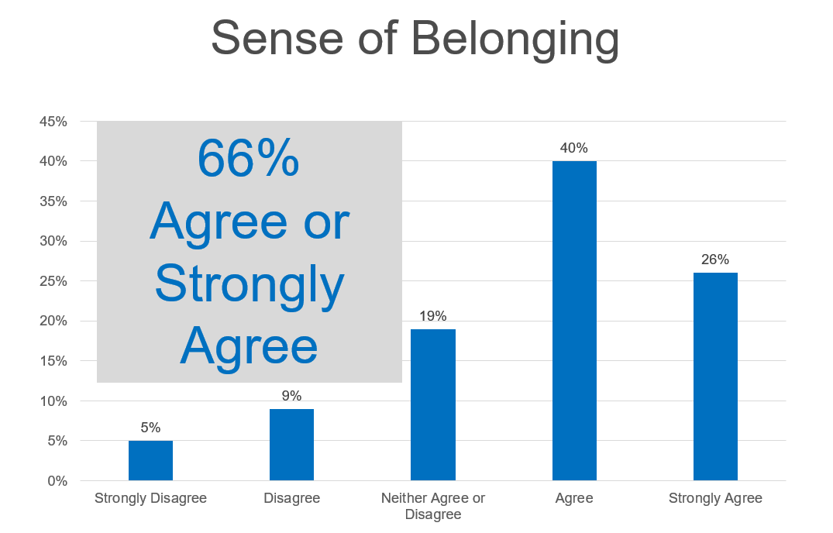

Slide 10
Engagement and Outcomes
 | Not Engaged | Engaged | High Engaged
Thought of Transferring | 33% | 30% | 22%
Thought of Discontinuing College | 22% | 14% | 10%
Satisfaction with Education | 0.9 | 1.1 | 1.2
Satisfaction with out of classroom experience | 0.6 | 1.0 | 1.4
Sense of Belonging - Member of community | 0.1 | 1.0 | 1.4
Sense of Belonging - Sense of belonging | 0.1 | 0.8 | 1.2
Resiliency - Able to adapt to change | 3.0 | 3.2 | 3.3
Resiliency - Tend to bounce back after hardship | 3.0 | 3.2 | 3.4
Learning outcomes - Make difference on campus | -0.6 | 0.3 | 1.0
Learning outcomes - Met individuals with different interests | 1.1 | 1.4 | 1.7
Learning outcomes - Met individuals with similar interests | 1.0 | 1.4 | 1.7
Drinking - Number of drinks when typically drink | 3.0 | 3.5 | 3.4
Stress - Level of stress in past two weeks | 3.0 | 3.0 | 3.0
GPA (SIS data) | 3.09 | 3.21 | 3.33

Slide 11
Satisfaction

Slide 12
Parent: How is School son?
Student: It is great, there is so much to do, I love it!
Parent: How are your classes?
Student: Not sure, there has been so much
other stuff to do…..

Slide 13
Data Science Process
Extensive data process of obtaining, cleaning, merging & carpentry
Python
Load and review, imputation of missing values, balance data, split data
Review regression and correlation
Run Machine Learn Algorithms

Slide 14
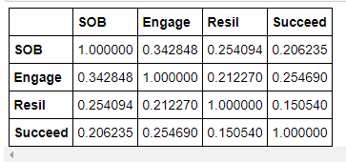
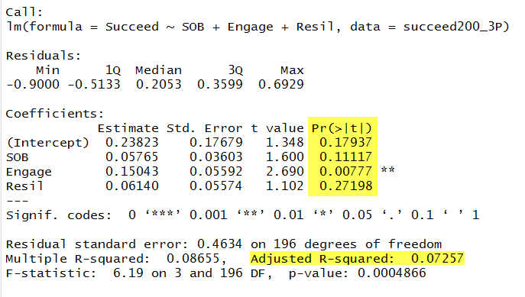
REVIEW REGRESSION AND CORRELATION

Slide 15
Machine Learning Results
LogisticRegression train = .69 test = .60
LogisticRegression(C=110) train = .70 test = .62
LogisticRegression(C=001) train = .67 test = .57
DescisionTree train = .81 test = .53
DescisionTree (Depth = 4) train = .74 test = .58
Random Forest train = .81 test = .53
Gradient Boost train = .79 test = .58
Gradient Boost (Depth =1 train = .72 test = .60
Gradient Boost (Learn rate =1) train = .72 test = .60
SVC train = .69 test = .62
SVC (C=1000) train = .80 test = .55
MLPClassifier train = .80 test = .55
MLPClassifier (max_iter = 1000) train = .80 test = .55
MLPClassifier (alpha = 1) train = .80 test = .55

Slide 16
Yet
Yet

Slide 17
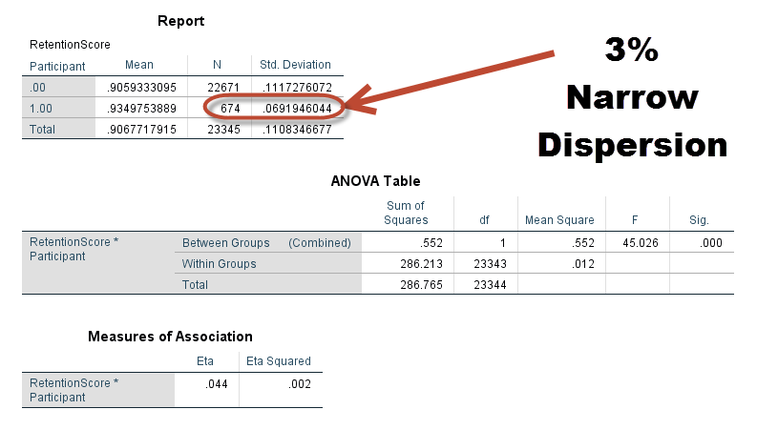
Why?

Slide 18
Random Sample we want
100%
Retention Score
0%

Slide 19
Sample we Got
100%
Retention Score
0%

Slide 20
Have information from this group
100%
Retention Score
Want to know about this Group
0%

Slide 21
Results
Student Affairs Key Performance Measures relate to each other, but not to intended outcomes
SOB – Engagement - Satisfaction
Resiliency and Thoughts of Leaving do not predict much
When comparing intend outcome proxies in the survey, things look good, but…..
When compared to System Level Data, Student Affairs Key Performance Measures do not predict SIS/MU Connect measures of Intended Outcomes
Academic Success
Retention
Graduation

Slide 22
Limitations
Student perceptions and intentions are gathered in Spring, rather than Fall Semester
A strong Selection Bias among survey respondents compared to non respondents
Respondents do not match type of students we want to know more about
Access to data is only recently becoming available.

Slide 23
Recommendations
Fall collection of Key Performance Measures
Summer collection of Intended Outcomes
Devise mean of assuring data from type of students we want to know more about
Continue improvement in data access and sharing
Allocation of resources to Student Affairs Assessment Team of Data Scientist
Avatar databases for strategic planning?

